Slide 1
Unit Testing
Various
ICT40120 Certificate IV in Programming

Slide 2
Overview
Unit testing background
Components of the Python unittest framework
Objective: by the end of this session you should be able to answer (1) why we unit test and (2) how to write simple unit tests with Python’s unittest module

Slide 3
What is unit testing?
It’s in the name… It tests units of code
For example: a single function
In an OO context, those units are usually classes
Preferably, unit testing is part of an automated process
Sometimes integrated into CI/CD workflow:
Commit a change ⇒ run tests ⇒ accept (or decline) change
Notes:
CI/CD ⇒ Continuous Integration / Continuous Deployment

Slide 4
Unit Testing
Usually when we say unit test we mean automated unit tests
In the context of OOP these are essential since testing the complete app is not always an option
A unit of code may not present any user-facing functionality in its own right.

Slide 5
Unit testing is crucial
Agile
CI/CD
DevOps
All modern methodologies rely heavily on the existence of automated unit tests
Without test automation none of these approaches could exist

Slide 6
Preamble structuring our project
Our applications now consist of multiple files and that number is about to grow with tests
We need to start thinking about how our projects are organized before we can start unit testing

Slide 7
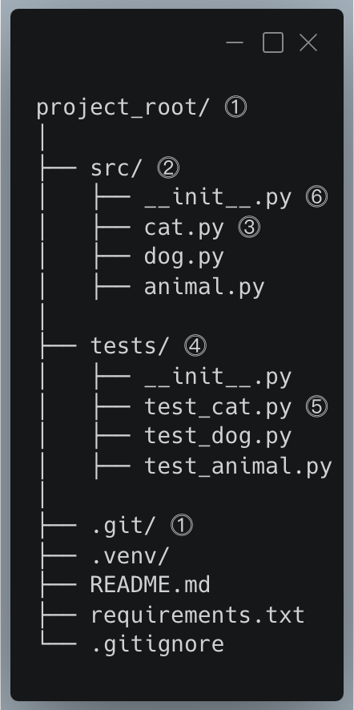
Typical project layout
1
The project root in PyCharm usually the git repo
2
Group source files together: usually but not always src
3
Typically, one file per class
4
Group tests in a tests folder very unusual to change the name
5
Usually one test_ prefixed or _test suffixed file per file in src
6
When we organize a program into multiple files we can mark the folder as a package by including __init__.py. This file can be empty and often is.
Notes:
Typical folder structure:
project_root/ # usually also git repo root
│
├── src/ # Directory for source files
│ ├── cat.py # Module for Cat-related functionalities
│ ├── dog.py # Module for Dog-related functionalities
│ ├── animal.py # Common module for general Animal attributes
│
├── tests/ # Directory for unit test files
│ ├── test_cat.py # Unit tests for functionalities in cat.py
│ ├── test_dog.py # Unit tests for functionalities in dog.py
│ ├── test_animal.py # Unit tests for common functionalities in animal.py
│
├── README.md # Project overview and general information
├── requirements.txt # File to list project dependencies
└── .gitignore # Specifies intentionally untracked files to ignore

Slide 8
Folder organization and imports
While organizing Python code into folders and sub folders is very common it is notoriously unintuitive
We want to focus on how to avoid common pitfalls without necessarily opening a can of worms that we don’t need to worry about for now

Slide 9
What you need to understand
We want to keep our tests separate from our source
But we need to import our modules into our tests
The root folder is always treated as the folder we run from
Until we run a test, then it changes to the root of the project
The simple solution is an environment variable called PYTHONPATH which we set to equal the src
This allows us to pretend the source files are in whatever folder we run from
PyCharm deals with this mess for us (may be all you need to know)

Slide 10

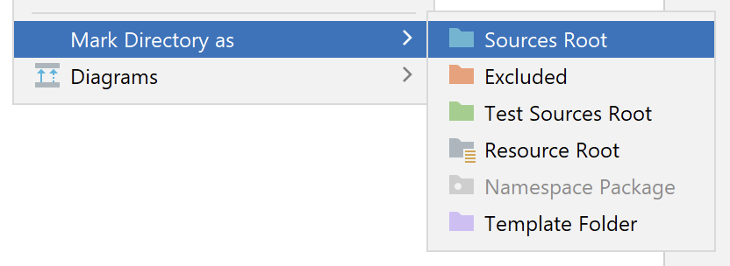
PyCharm: Always do this
Always mark the source root (it will set the Python path)
Also mark the tests root (see if you can figure it out)
src/

Slide 11
Activity
Organize your project into src/ and tests/ folders
Ensure from <some_file_in_src> import <some_module> works from a file in your tests

Slide 12
Testing in Python
Built-in:
doctest
unittest
Popular:
pytest

Slide 13
unittest
Python provides the unittest framework
Inspired by JUnit
Key concepts used in unit testing:
Test, Test Case
Test runner
Coverage

Slide 14
Python unittest and AAA
Arrange: with setUp, tearDown, and fixtures
Act: Perform the operation you want to test
Assert: Use a variety of assertions to check for success or failure

Slide 15
Test case
This is the individual unit of testing
Test cases are derived from the base class TestCase

Slide 16
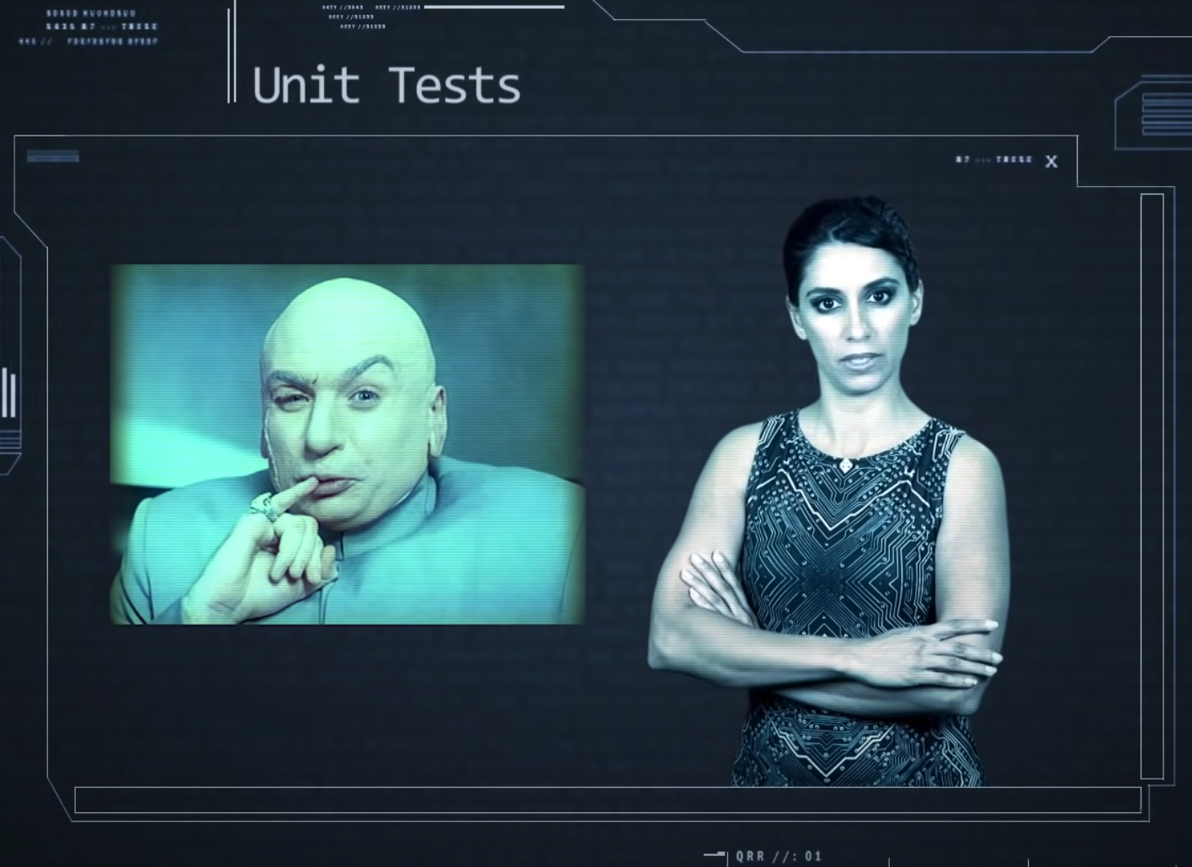
Video: Socratica on Python unit testing
Link: https://www.youtube.com/watch?v=1Lfv5tUGsn8
Notes:
https://www.youtube.com/watch?v=1Lfv5tUGsn8

Slide 17
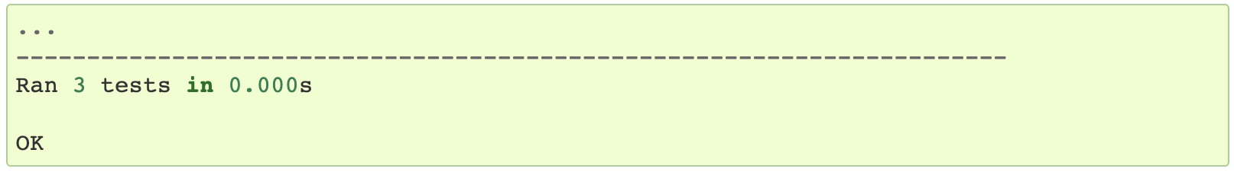
Test runner
Runs the tests and conveys the results (pass/fail) to the user
Example output of a successful run:

Slide 18
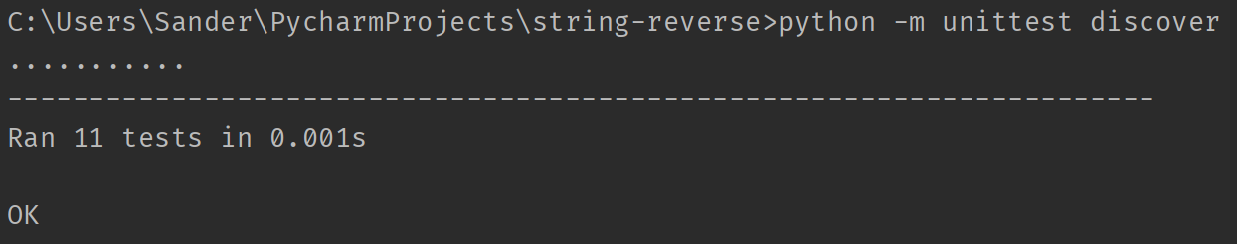
Running unit tests
This will automatically discover unit tests
If the terminal in PyCharm doesn’t work, use a regular terminal

Slide 19
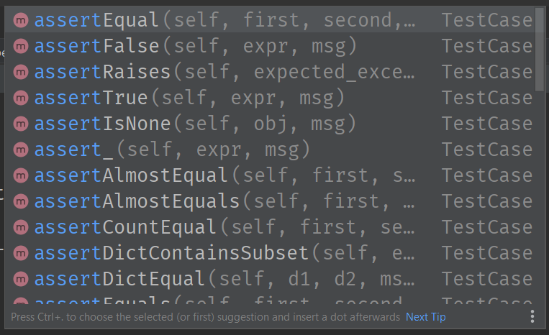
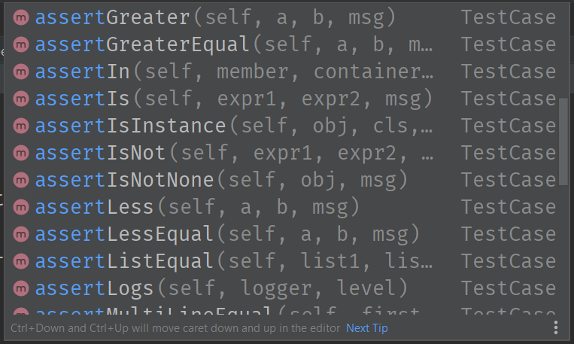
Assertions
There are numerous assertions available

Slide 20
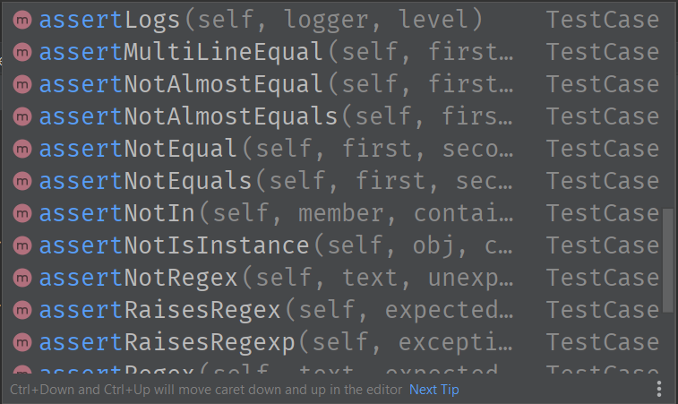
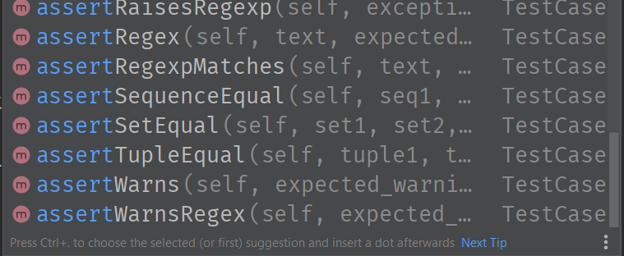
Assertions
There are numerous assertions available

Slide 21
Common assertions
We’ve seen assertTrue (assertFalse tests opposite)
self.assertEquals(a, b) compares two values a and b
If a != b, an exception is raised, and the test fails.
A third parameter can be used as a “message” field, which will be shown if the test fails.

Slide 22
Common assertions
If you want to test whether an exception is raised:
def test_exception_is_raised(self):
# You can tell which exception is expected
with self.assertRaises(IndexError):
self.stack.push(3)
Please note that the Socratica video shows another method of checking for exceptions.
Notes:
This technique uses a context manager (the “with” statement).

Slide 23
Exercise 1 – In class
Write a function that calculates the sum of two numbers
Call it add or add2, not sum (that is a built-in function)
Include a docstring!
Write the unit tests that check:
that correct values are calculated for integer, floating point, and complex numbers (e.g., 2 - 1j is complex)
that a TypeError is raised if any of the arguments is not a valid type
Question:
do you need to test for a ValueError like in the Socratica video?

Slide 24
Exercise 2 - SOCA
Download the file string_num_value.zip from Blackboard
Unpack it somewhere and load it as a project in your IDE
Probably PyCharm
Run the unit tests from within the IDE
Can you make any of the tests fail?
Can you implement the missing functionality and the test that goes with it?
Notes:
SOCA = Structured Out of Class Activities

